Slide 1
math coprocessor
Farhan Sadaf
Lecturer, Dept. of CSE

Slide 2
coprocessor
A coprocessor is a computer processor used to supplement the functions of the primary processor (the CPU).
An extra processor in a computer that is designed to perform specialized tasks (as mathematical calculations)
Operations performed by the coprocessor may be floating point arithmetic, graphics, signal processing, string processing, encryption or I/O Interfacing with peripheral devices.

Slide 3
Why we need a math coprocessor?
Using a general-purpose microprocessor such as the 8088/86 to perform mathematical functions such as log, sine, and others is very time consuming, not only for the CPU but also for programmers writing such programs.
In the absence of a math coprocessor, programmers must write subroutines using 8088/86 instructions for mathematical functions.

Slide 4
Why we need a math coprocessor?
In an application where you need a calculation to be done as quickly as possible.
The architecture and instruction sets of general purpose microprocessor such as 8086 are not designed to do complex mathematical operations efficiently.
Even highly optimized number-crunching programs run slowly on these general purpose machines.
To solve this problem, special processors with architectures and instruction sets optimized for number-crunching have been developed.
An example of this number crunching processor is the Intel 8087 math processor.

Slide 5
8087 NDP (Numeric Data Processor)
It is a processor which works in parallel with the main processor.
Therefore, it is referred to as a coprocessor.
It has its own set of specialized instructions.
The number crunching part of the program is executed by 8087.
Instruction for 8087 are written in the main program interspersed with the 8086 instructions.
8086 handles the general program instructions and 8087 processor handle specialized math computation

Slide 6
8087 NDP
8086 and 8087 both read same instructions from memory and put in their internal instruction queue.
8087 does the same thing.
The 8087 decodes each instruction that comes into its queue.
When it decodes an instruction from its queue and finds that it is an 8086 instruction, the 8087 simply treats the instruction as an NOP.
The 8086 also does the same.
That means each processor decodes all the instructions in the fetched instruction byte stream but executes only its own instruction.
All the 8087 instruction codes have 11011 as the most significant bits of their first code byte.
To differentiate the instructions used for 8087 here all the mnemonics begins with ‘f´. For example ,in contrast to add/mul, in 8087 there is fadd/fmul

Slide 7
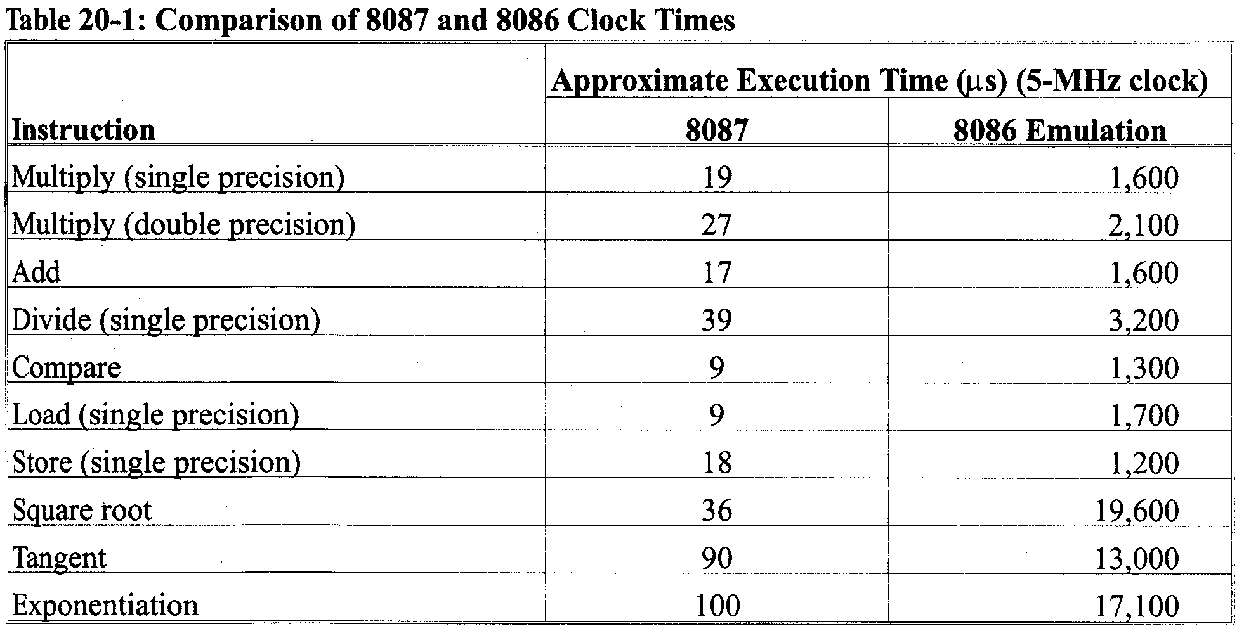
Comparison of 8087 and 8086 Clock Times
In some cases the differences of run times is hours between PCs with and without math-coprocessor.

Slide 8
8087 data types
Binary integers
Packed decimal numbers
Real numbers

Slide 9
Binary integers
Three formats of binary integer.
15 | 0
S | magnitude
Word Integer (16 bits)
31 | 0
S | magnitude
Short Integer (32 bits)
63 | 0
S | magnitude
Long Integers (64 bits)
The most significant bit is a sign bit which is 0 for positive numbers and 1 for negative numbers.
The other bits represent magnitude of a number.
If the number is negative, the magnitude of the number is represented in 2’s complement form.

Slide 10
Packed decimal numbers
The binary coded decimal (BCD) form requires 80 bits of memory.
Each number is stored as an 18-digit packed integer in nine bytes of memory as two digits per byte.
The tenth byte contains only a sign bit for the 18-digit signed BCD number.
79 |  |  |  |  |  |  |  |  |  | 0
S | d17 | d16 | d15 | d14 | d13 | d12 | d11 | d10 | d9 | d8 | d7 | d6 | d5 | d4 | d3 | d2 | d1 | d0

Slide 11
Real numbers
Floating point numbers are often called real numbers because they hold signed integers, fractions and mixed numbers.
A floating point number has three parts: a sign-bit, a biased exponent and a significand.
Floating point numbers are written in scientific binary notation.
Three types of floating point numbers:
short (32 bits),
long (64 bits),
temporary (80 bits).

Slide 12
Floating Point Arithmetic (Real)
The goal of floating point representation is represent a large range of numbers
Important Terms
Given the number -1.234 x 10²
Sign = negative
Mantissa = .234
Exponent = 2

Slide 13
Storage Components
The Sign
The sign is positive(a 0 bit) or negative (a 1 bit)
The Mantissa (Significand)
The bits to the right of decimal point is the mantissa or significand.
The numeral to the left of the decimal point is ALWAYS 1 (normalized notation).
The Exponent
The exponent can be either positive or negative. The exponent is biased by +127.

Slide 14
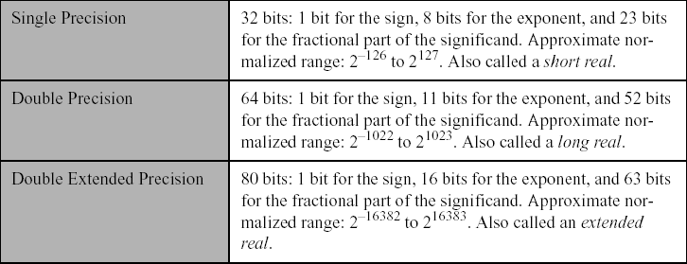
Data Type (REAL)

Slide 15
Real numbers
31 | 30 | 23 | 22 | 0
S | Biased exponent |  | Magnitude
63 | 62 | 52 | 51 | 0
S | Biased exponent |  | Magnitude
79 | 78 | 64 | 63 | 0
S | Biased exponent |  | 1 | Magnitude
Short with a bias of 7FH (127D).
Long with a bias of 3FFH (1023D).
Temporary with a bias of 3FFFH(16383D).

Slide 16
The Significand Must be Normalized
1234.567 = 1.234567 x 10³
Numbers are normalized by moving the decimal point so that only one digit appears to the left of the decimal point.
1101.101 = 1.101101 exponent = 3
0.00101 = 1.01 exponent = -3
Note that the leading 1 is omitted from storage

Slide 17
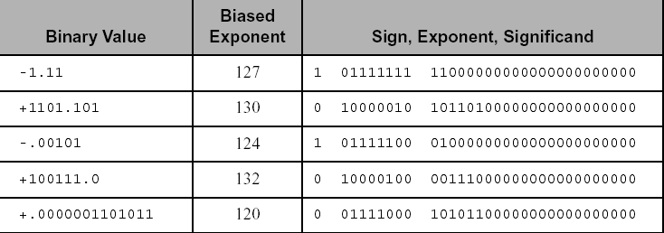
Short real Representation

Slide 18
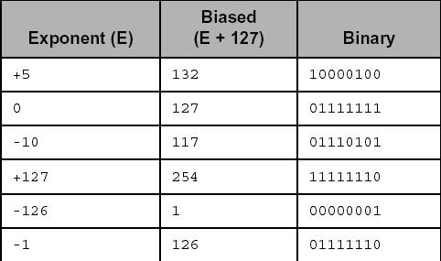
The Exponent is Biased by +127

Slide 19
Exponent Encoding
Exponent encoding is bias 127. To get the encoding, take the exponent and add 127 to it.
If exponent is –1, then exponent field = -1 + 127 = 126 = 7Eh If exponent is 10, then exponent field = 10 + 127 = 137 = 89h

Slide 20
Converting to floating point form
Convert the decimal number into binary.
Normalize the binary number.
Calculate the biased exponent.
Store the number in the floating-point format.

Slide 21
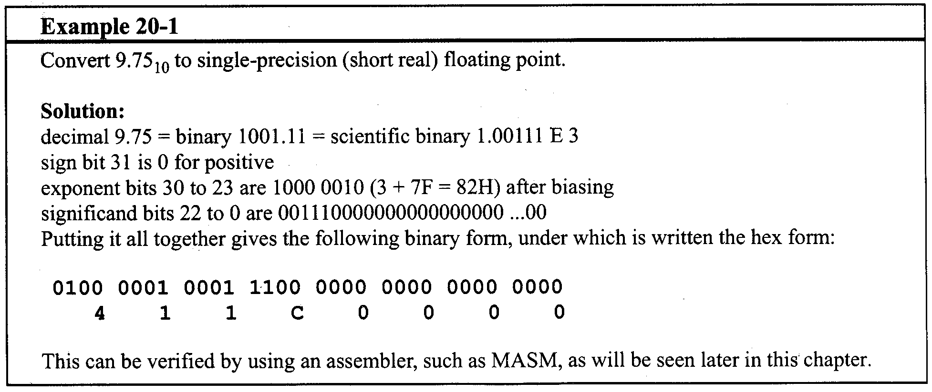
Convert 9.75 to single-precision floating point
Notes:
Float to binary conversion: https://www.log2base2.com/number-system/float-to-binary-conversion.html

Slide 22
Convert FP Decimal to binary encoding What is the number -28.75 in Single Precision Floating Point?
1. Ignore the sign, convert integer and fractional
part to binary representation first:
a. 28 = 0001 1100
b. .75 =.11
-28.75 in binary is -00011100.11 (ignore leading zeros)
2. Now NORMALIZE the number to the format
1.mmmm x 2exp
Normalize by shifting. Each shift right add one to
exponent, each shift left subtract one from exponent:
- 11100.11 x 2⁰ = - 1110.011 x 2¹
= - 111.0011 x 2²
= - 1.110011 x 2⁴

Slide 23
Convert Decimal FP to binary encoding (cont)
Normalized number is: - 1.110011 x 2⁴
Sign bit = 1
Significand field = 110011000...000
Exponent field = 4 + 127 = 131 = 83h = 1000 0011
Complete 32-bit number is:
1 10000011 110011000….000
Sign exponent mantissa

Slide 24
Converting from floating-point form
Separate the sign-bit, biased exponent and significand.
Convert the biased exponent into a true exponent by subtracting the bias.
Write the number as a normalized binary number.
Convert it to a de-normalized binary number.
Convert the de-normalized binary number to decimal.

Slide 25
Converting from floating-point form
Step | Result
1 | Sign = 1 Exponent = 10000011 Significand = 10010010000000000000000
2 | 10000011 – 01111111 = 100
3 | 1.1001001 X 2⁴
4 | 11001.001
5 | -25.125

Slide 26
Convert Floating Point Binary Format to Decimal 1 10000001 01000000000000000000000
What is the number shown?
Sign bit = 1, so negative.
Exponent field = 81h = 129. Actual exponent = Exponent field – 127 = 129 – 127 = 2.
Number is: -1 . (01000...000) x 2² =-101.00
= -5.0.

Slide 27
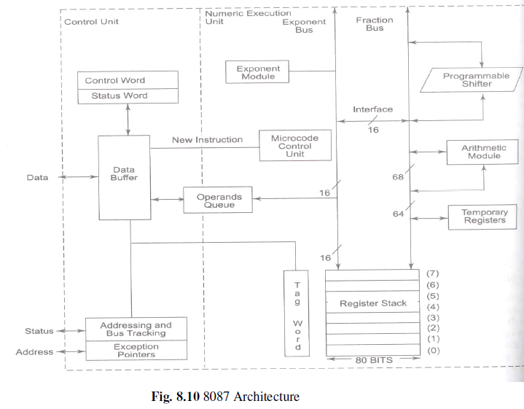
Architecture of 8087

Slide 28
Two major sections:
Control unit
Numeric Execution unit
Control Unit :
Function :
It interface the coprocessor to the microprocessor – system data bus.
Monitors the instruction stream.
If the instruction is an Escape(coprocessor) instruction, the coprocessor executes it; if not the microprocessor executes it.
It receives , decodes instructions, read and write memory operands and executes the 8087 instruction.

Slide 29
Numeric Execution Unit (NEU)
Functions :
Execute all the numeric processor instructions.
It has 8 register (80 bit) stack that holds the operands for arithmetic instructions & the result.
It uses push and pop mechanism to store and retrieve data.

Slide 30
Microcode control unit :
It generates the control signals required for the execution of instruction.
The internal data bus is 84 bits wide including 68 bit fraction, 15 bit exponent and a sign bit.

Slide 31
8087 register stack
The 8087 works internally with all numbers in the 80-bit temporary-real format.
To hold numbers being work on, the 8087 has a register stack of eight 80-bit registers, labeled (0)-(7).
These registers are used as a last-in-first out stack in the same way the 8086 uses a stack.
The 8087 has a 3-bit stack pointer which holds the number of the register that is the current top of stack (TOS).
When the 8087 is initialized , the 3-bit stack pointer in the 8087 is loaded with 000, so register 0 is then the TOS.

Slide 32
8087 register stack
The register that is currently the TOS is referred to as ST(0) or simply ST.
During PUSH, SP is decremented by 1. Therefore, SP = 111 and hence the data is stored at register 7. So register 7 becomes ST (0).
During POP, data is read from top of stack and SP is incremented by 1. Therefore, SP = 000 so register 0 becomes ST (0).
It is a circular stack i.e. after pushing 8 elements if we PUSH the 9th element it will overwrite on the 1st element itself.

Slide 33
8087 register stack
The register just below this in the stack is referred to as ST(1).
By the register “just below” mean the register that the stack pointer would be pointing to if we popped one number off the stack.
For example, register 000 would be ST(1) after first push.

Slide 34
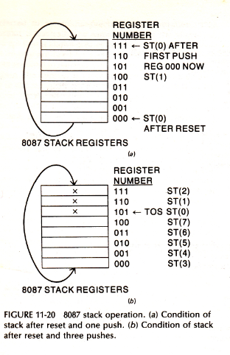
8087 register stack

Slide 35
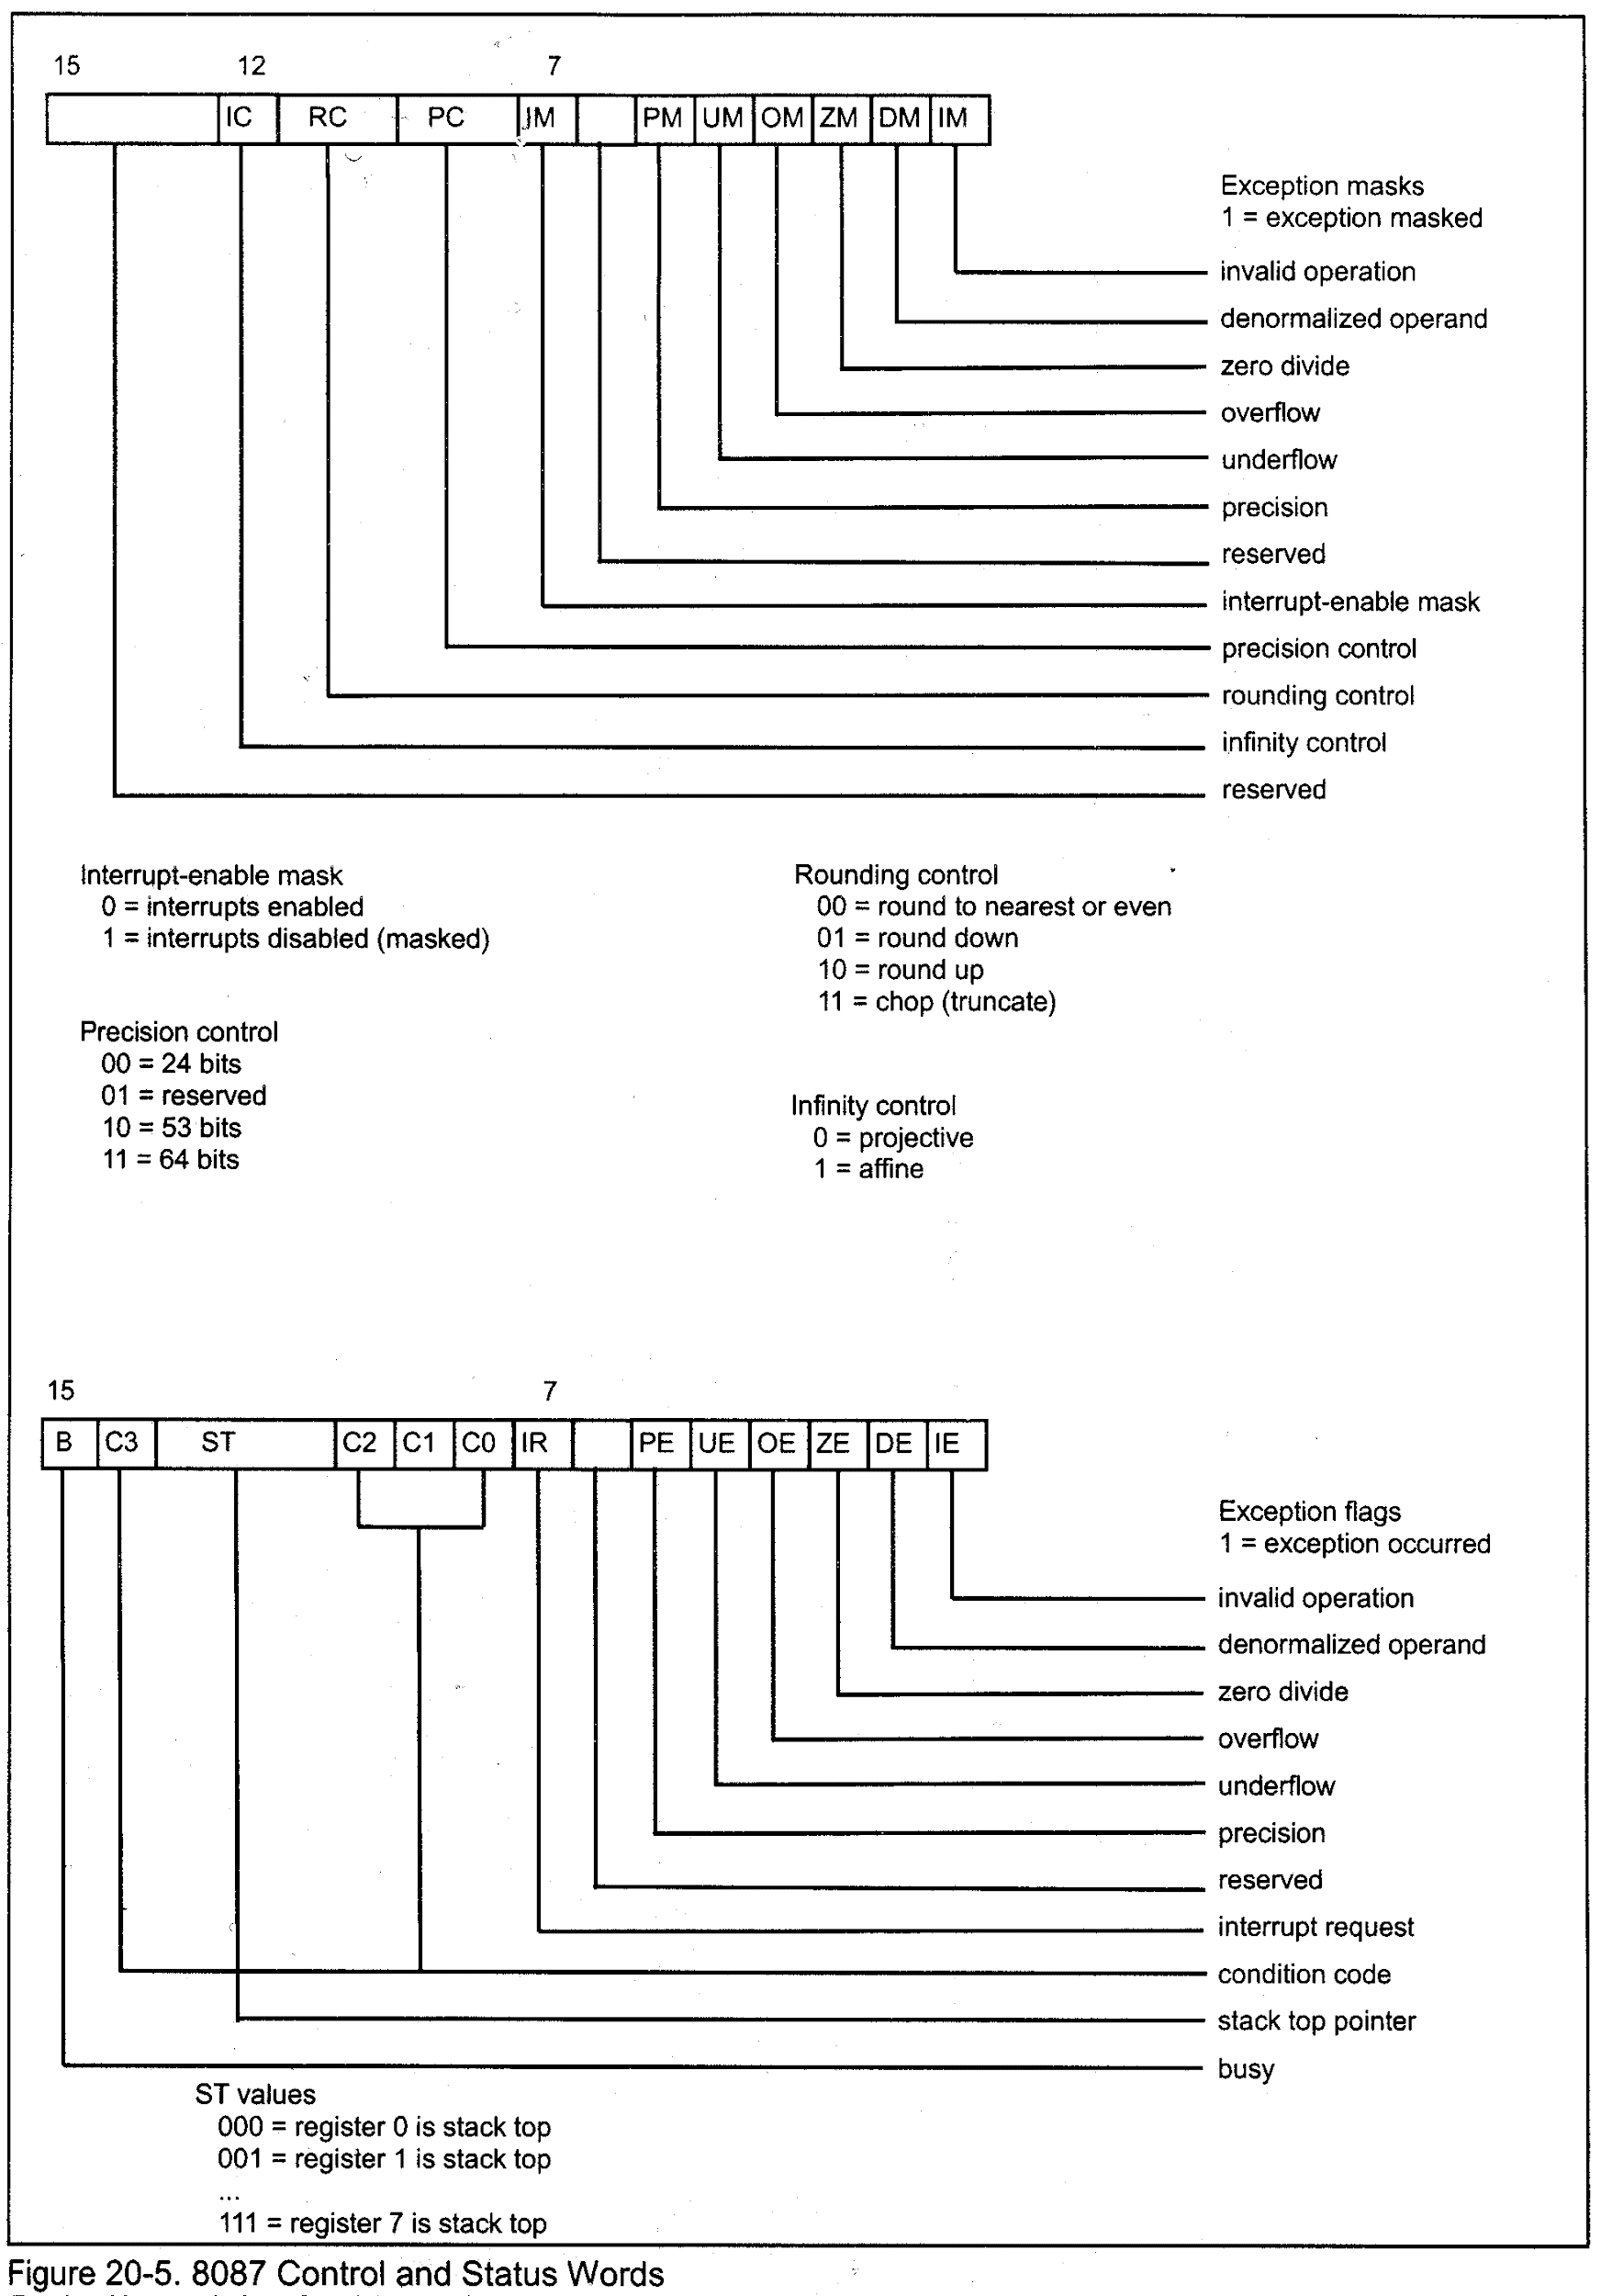
Status Register of 8087

Slide 36
B – Busy bit
Indicates the coprocessor is busy in executing a task.
C3- C0 (Condition code bits)
Indicates the condition of the coprocessor.
TOP ( Top-of-stack (ST))
Indicates the current register addressed as the top-of-the stack (ST). Normally register 0.
ES – Error Summary
Bit is set if any unmasked error bit (PE,UE,OE, ZE, DE or IE) is set.
PE – Precision error
Indicate the result or operand exceed the selected precision.

Slide 37
6) UE – Underflow Error
Indicates a non zero result that is too small to represent with the current precision selected.
7) OE – Overflow Error
Indicates a result is too large to be represented.
8) ZE – Zero Error
Indicates the divisor was zero while the dividend is a non-infinity or non zero number.
9) DE – Denormalized error
Indicates that at least one of the operands is denormalized.
10) IE – Invalid Error
Flag indicates errors such as those produced by taking the square root of negative number.

Slide 38
Control register of 8087

Slide 39
Control register
IC – Infinity Control
Selects either affine ( allows positive and negative infinity) or projective (assumes infinity is unsigned)
RC – Rounding Control
Determines the type of rounding.
00 - round to nearest even.
01 - round down towards minus infinity.
10 - round up towards plus infinity.
11 - chop or truncate toward Zero.

Slide 40
3) PC – Precision Control
Sets the precision of the result.
00 -> Single precision (short)
01 -> Reserved
10 -> Double – precision (long)
11 -> Extended precision (temporary)
4) Exception Masks
Determine whether the error indicated by the exception affects the error bit in the status flag.
5) Zero Divide
If any non zero finite operand is divided by zero, this exception is generated.
6) Denormalized Operand
Exception is generated if at least one of the operand or the result is denormalized.

Slide 41
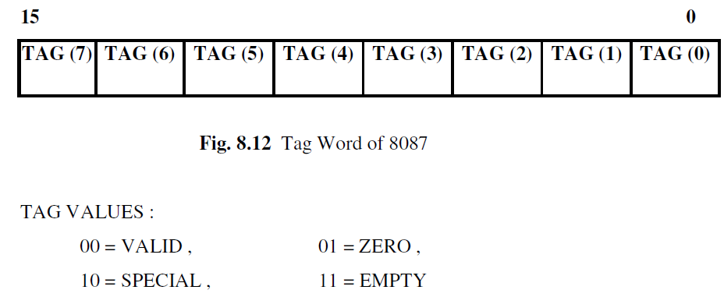
Tag register
The tag register indicates the contents of each location in the coprocessor stack.
Corresponding to each of the 8 registers, there is a two bit TAG field to indicate the status of contents

Slide 42
80287 Coprocessor
The 80287 is also a math coprocessor which works in conjunction with 80286 microprocessor.
It performs arithmetic, logarithmic, exponential and trigonometric functions.
It handles 32 and 64 bit integers; 32,64 and 80-bit real; and 18-digit BCD operands.
It also contains 8 80-bit registers, control registers, status registers and tag words like as 8087.
The 8 80-bit registers are used as data register to hold the operands during the operations.

Slide 43
80287 Coprocessor (cont’d.)
These registers can be accessed either as a stack or as individually addressable register.
The 16 bit status register gives the overall state of the 80287 coprocessor.
The coprocessor contains a control word register which holds the control word for the coprocessor.
The 80287 is capable of providing several processing options which can be selected by loading a control word from the memory into the control word register.

Slide 44
80287 Coprocessor (cont’d.)
A 2-bit tag word points to the contents of each data register whether it is valid, zero, special or empty.
It is object code compatible with 8087 coprocessor.

Slide 45
80387 Coprocessor
Same as 80287 coprocessor.
Self Study.

Slide 46
82786 Coprocessor
The 82786 is a graphics coprocessor which works with all Intel microprocessors.
It is a high performance replacement for subsystem and boards, which use discrete components for graphics function.
It is an intelligent peripheral device capable of both drawing and refreshing raster display.
It provides hardware supports for fast manipulation and display of multiple windows on the screen.
It can support high resolution displays and can display up to 256 colors simultaneously.

Slide 47
82786 Coprocessor
It has fast polygon and line drawing capability and high speed character drawing capacity.
It has integral DRAM/VRAM controller, shift registers and DMA channel.

Slide 48
Thank You!

